Slide 1
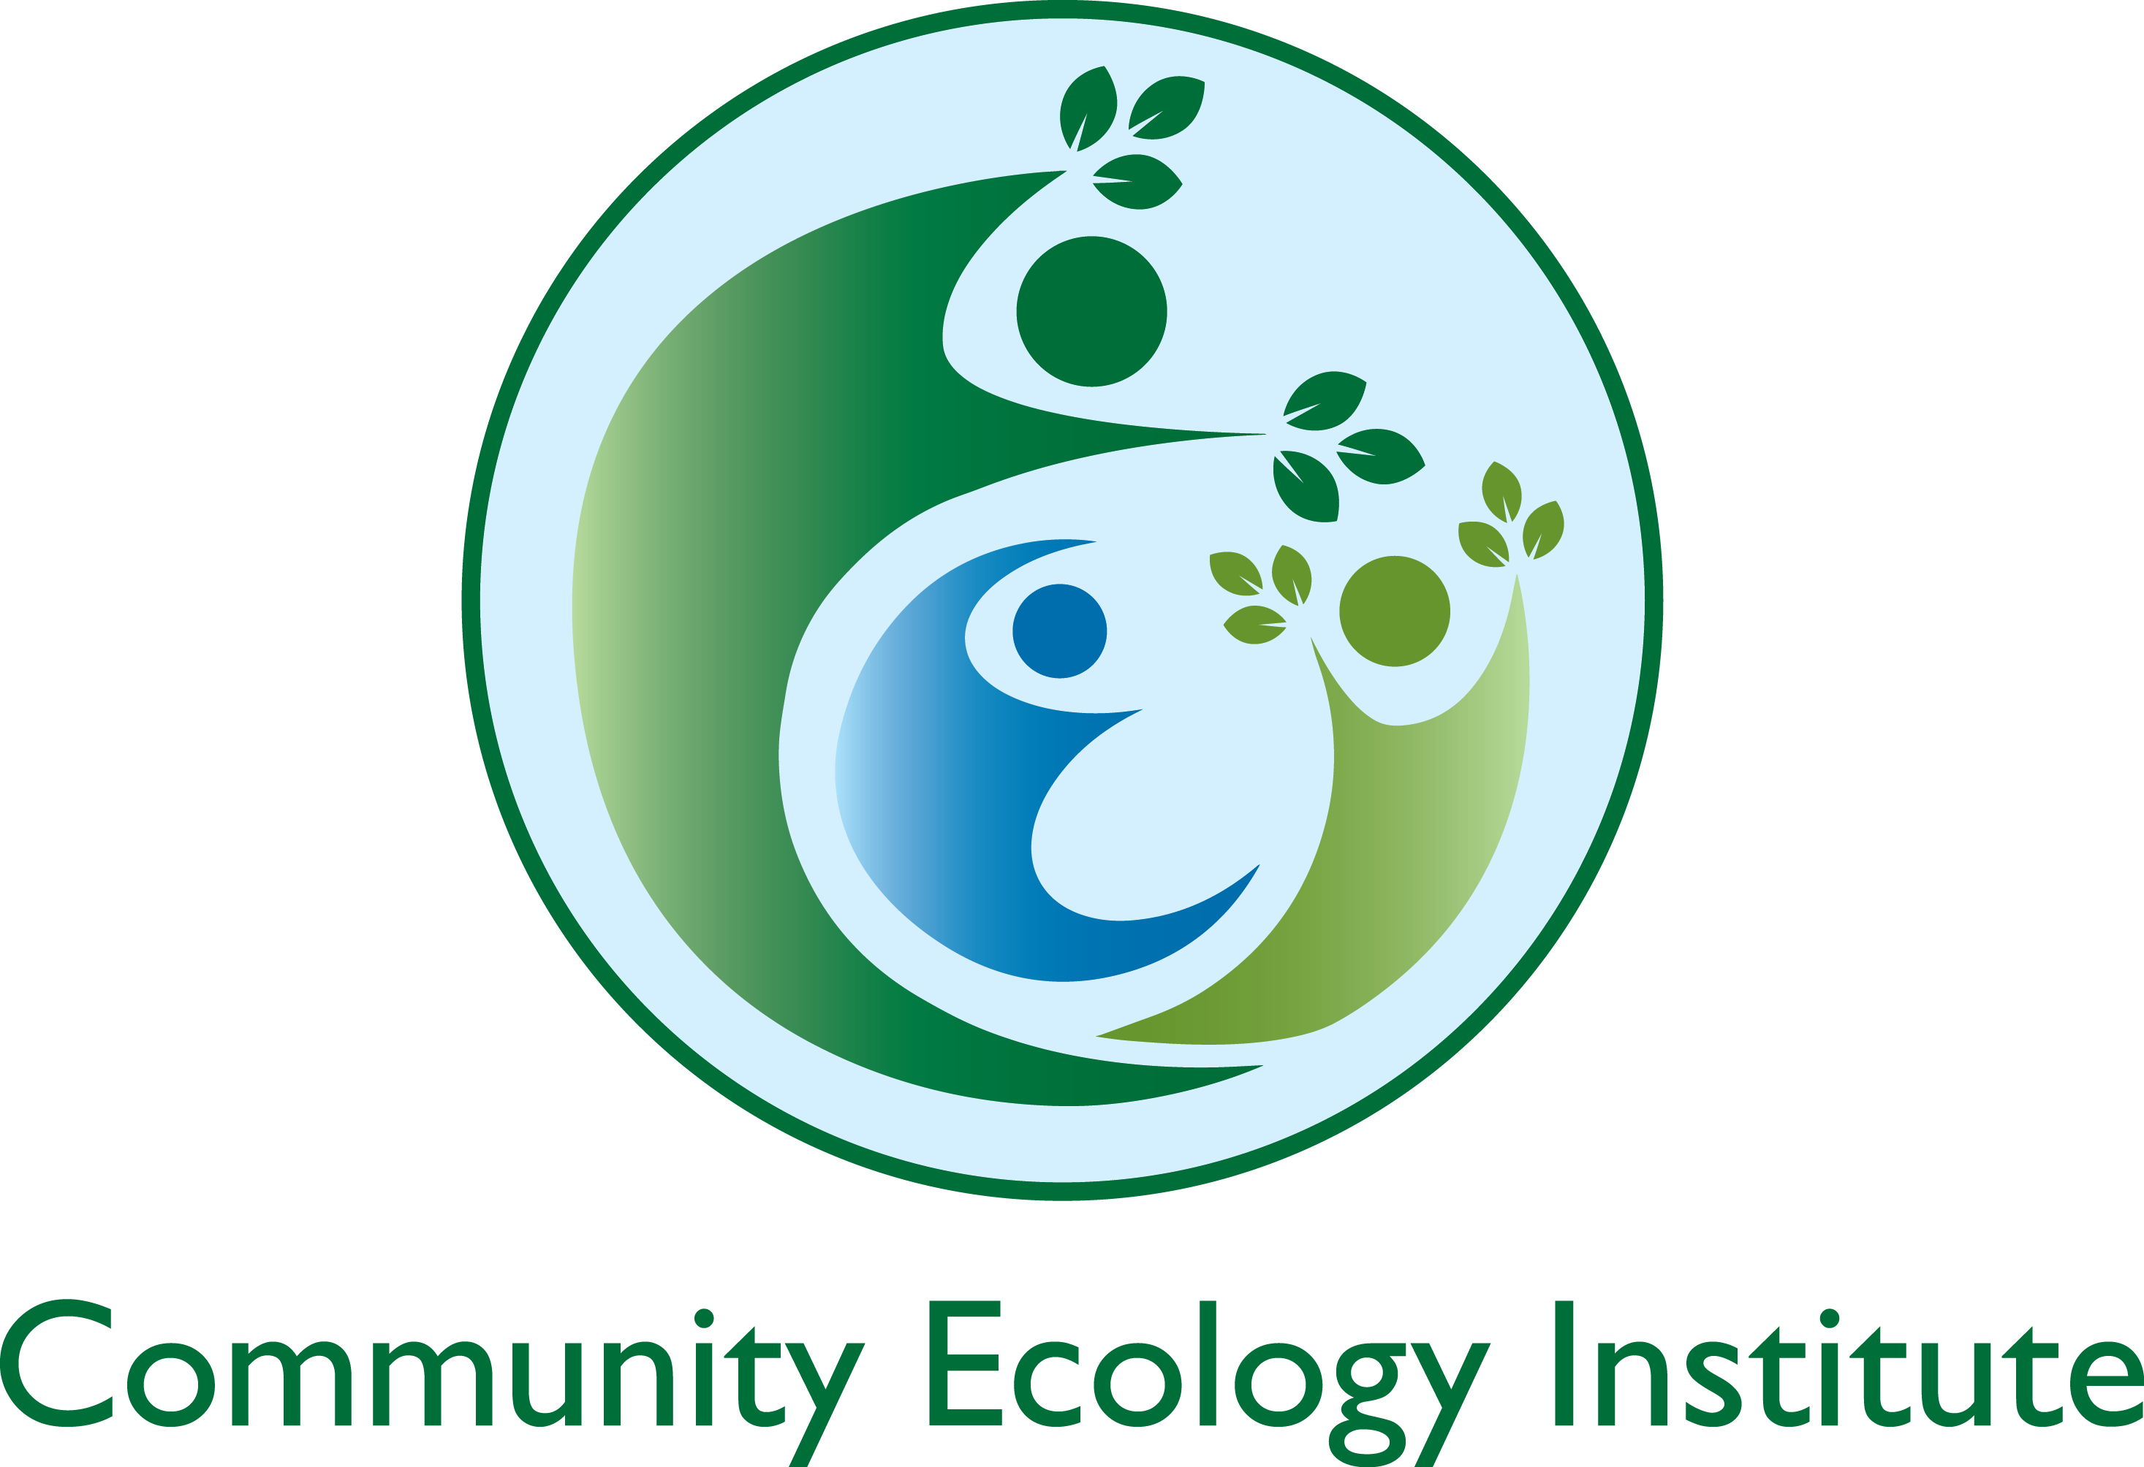
Walkable Watershed: Using a Neighborhood’s Stormwater Challenges to Build Community and Enhance Education
Funded by a Green Streets, Green Jobs, Green Towns Grant from the Chesapeake Bay Trust
Community Engagement Presentation
Notes:
In 2019, CEI purchased the last working farm in the city of Columbia, Maryland, to protect it from housing development and create an experiential environmental education center where people can learn from direct experience how to lead happier, healthier, more connected and sustainable lives. This 6.4-acre regenerative farm is located in a historic African-American community less than a quarter of a mile from the Middle Patuxent River. At the time of our purchase, stormwater from neighboring Atholton High School was bypassing their stormwater management infrastructure and flowing directly on to the farm via a culvert and underground pipe. The previous farm owner had piped this incoming water to the edge of the property, allowing the flooding and erosion in the neighborhood to continue southwest towards the river. Stormwater runoff from the school also flowed across Harriet Tubman Lane and a bus yard and onto the farm, causing flooding for the farm as well as surrounding properties. After hearing from numerous neighbors about the ongoing frustration and damage caused by this stormwater management problem, CEI decided to take the lead on trying to create a solution.

Slide 2
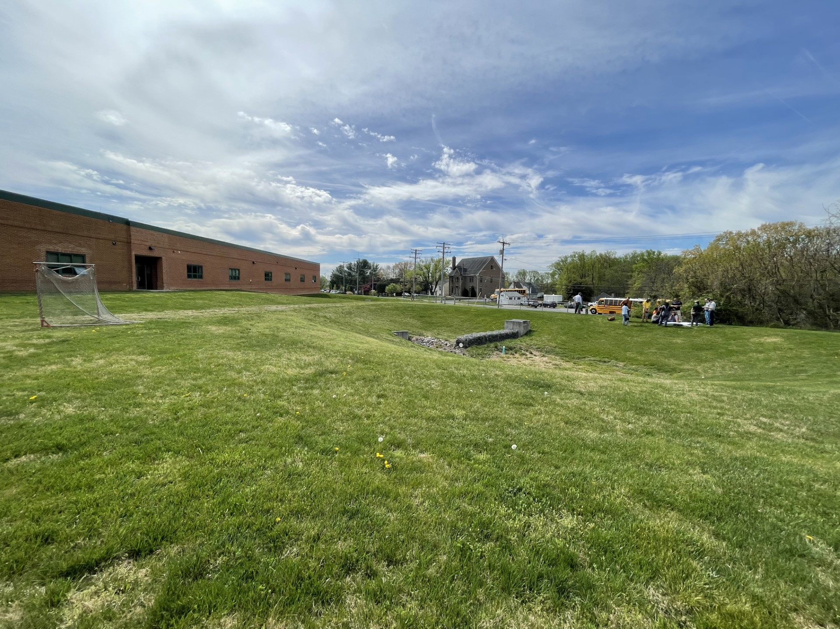
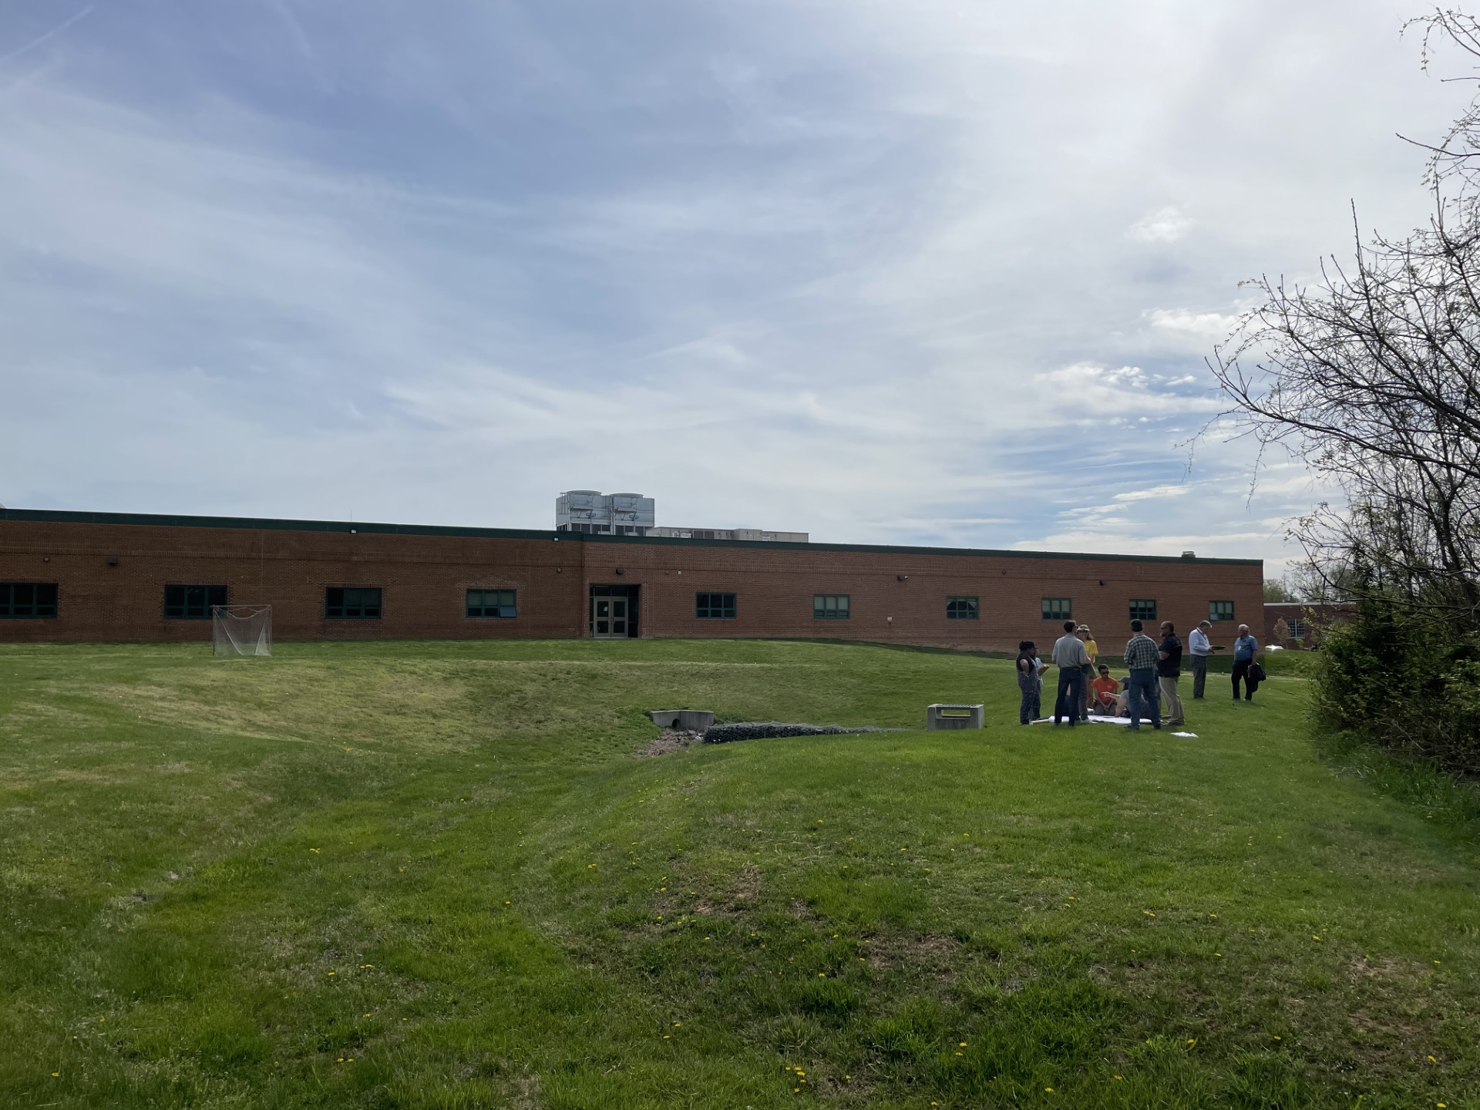
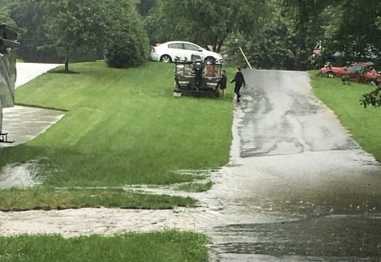
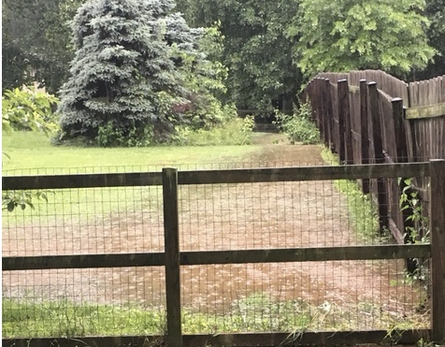
Pre-project conditions
Notes:
CEI began conversations with Atholton High School and determined that together we are in a unique position to both support the health of the Middle Patuxent watershed through treatment of a significant volume of stormwater runoff and to also demonstrate how a community can work together to address stormwater issues in a socio-ecologically beneficial way. From 2019 to 2021, CEI completed three Chesapeake Bay Trust grants (which were partially funded by Howard County) that allowed us to create an ecological master plan for Freetown Farm, develop an engineered design for how to address the stormwater we were receiving from Atholton, and implement best management practices (BMPS), such as a sizeable bioretention pond fed by an input area improved with berms and swales, and surrounded by a native pollinator meadow. This work has led to much less stormwater leaving Freetown Farm (because it now infiltrates into the ground!) and flowing to our neighbors to the west, but there isn’t the ability to hold all the water coming off Atholton during heavy storms at Freetown Farm, so we still needed to look upstream to the source of the issue. In 2020 we successfully applied for phase one of the Chesapeake Bay Trust’s Green Streets, Green Jobs, Green Towns (G3) grant to develop a green stormwater infrastructure concept plan for Atholton High School using a selection of integrated best management practices. Phase two of this new grant series was the completion of the engineered design for the project and phase three was implementation of the project. Completed in late October, this project now provides highly visible demonstrations of BMPs, achieves health benefits for the Middle Patuxent Watershed, addresses chronic neighborhood stormwater flooding, and provides an outdoor education space for the school and community.

Slide 3
Notes:
Our work at Freetown Farm and Atholton High School is essential to the larger Walkable Watershed Initiative that CEI recently co-created with the community through a National Fish and Wildlife Foundation (NFWF) grant. This initiative addresses stormwater management issues while simultaneously addressing community needs and neighborhood quality of life goals, such as improved neighborhood connectivity, better access to vibrant outdoor spaces, and a sense of synergy among the community’s diverse assets. In other words, a walkable watershed integrates the flow of water and people into a cohesive strategy to improve the overall health of a community and the surrounding watershed. During the development of the Freetown Walkable Watershed report, stakeholders from county and community organizations shared input about initiatives planned and underway across the county and within their organizations that resonate with the approach or are relevant to the stormwater and connectivity goals and challenges in the project area. Several existing and proposed projects, such as those documented in WalkHoward and BikeHoward plans align with the needs and concerns identified by the community and studies of the project area. Additionally, leaders of local development and redevelopment projects such as new senior housing at Brightview Columbia, the Harriet Tubman Center, and the Hickory Ridge Village Center have identified interests that support the need to address connectivity challenges and watershed health.

Slide 4
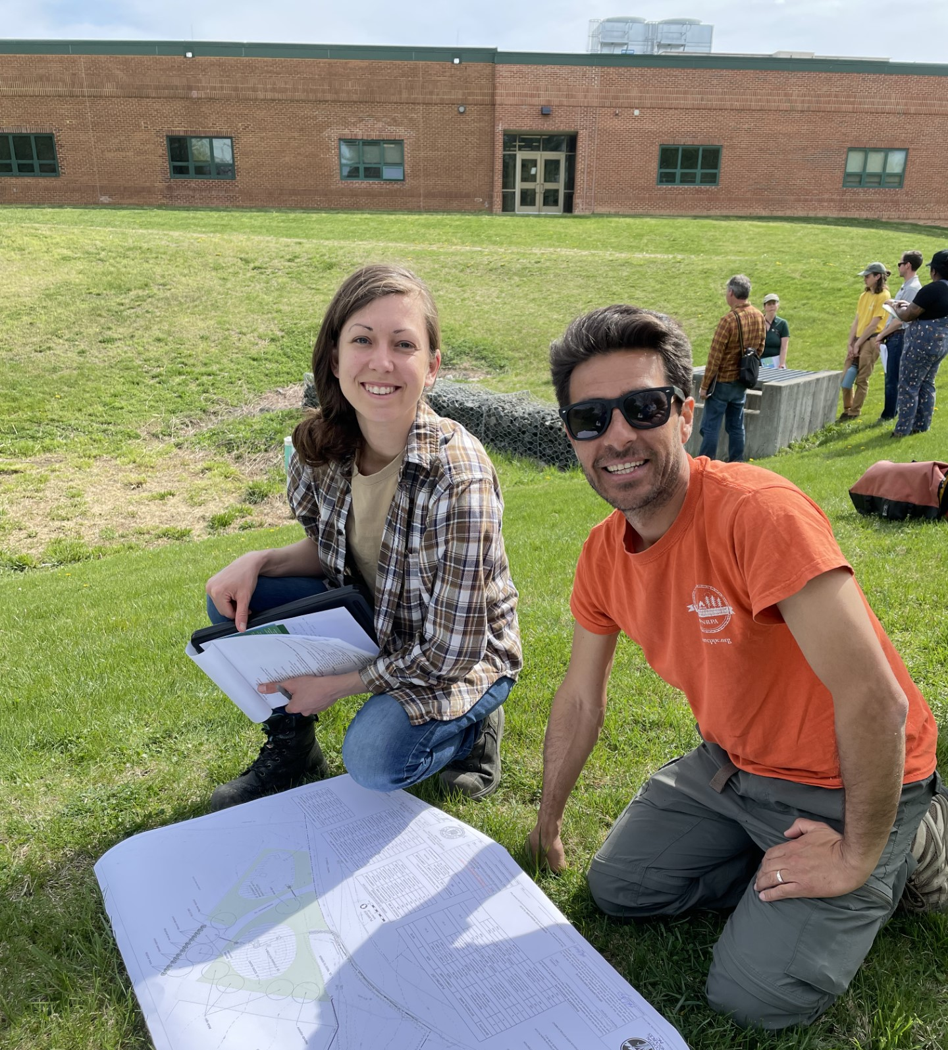
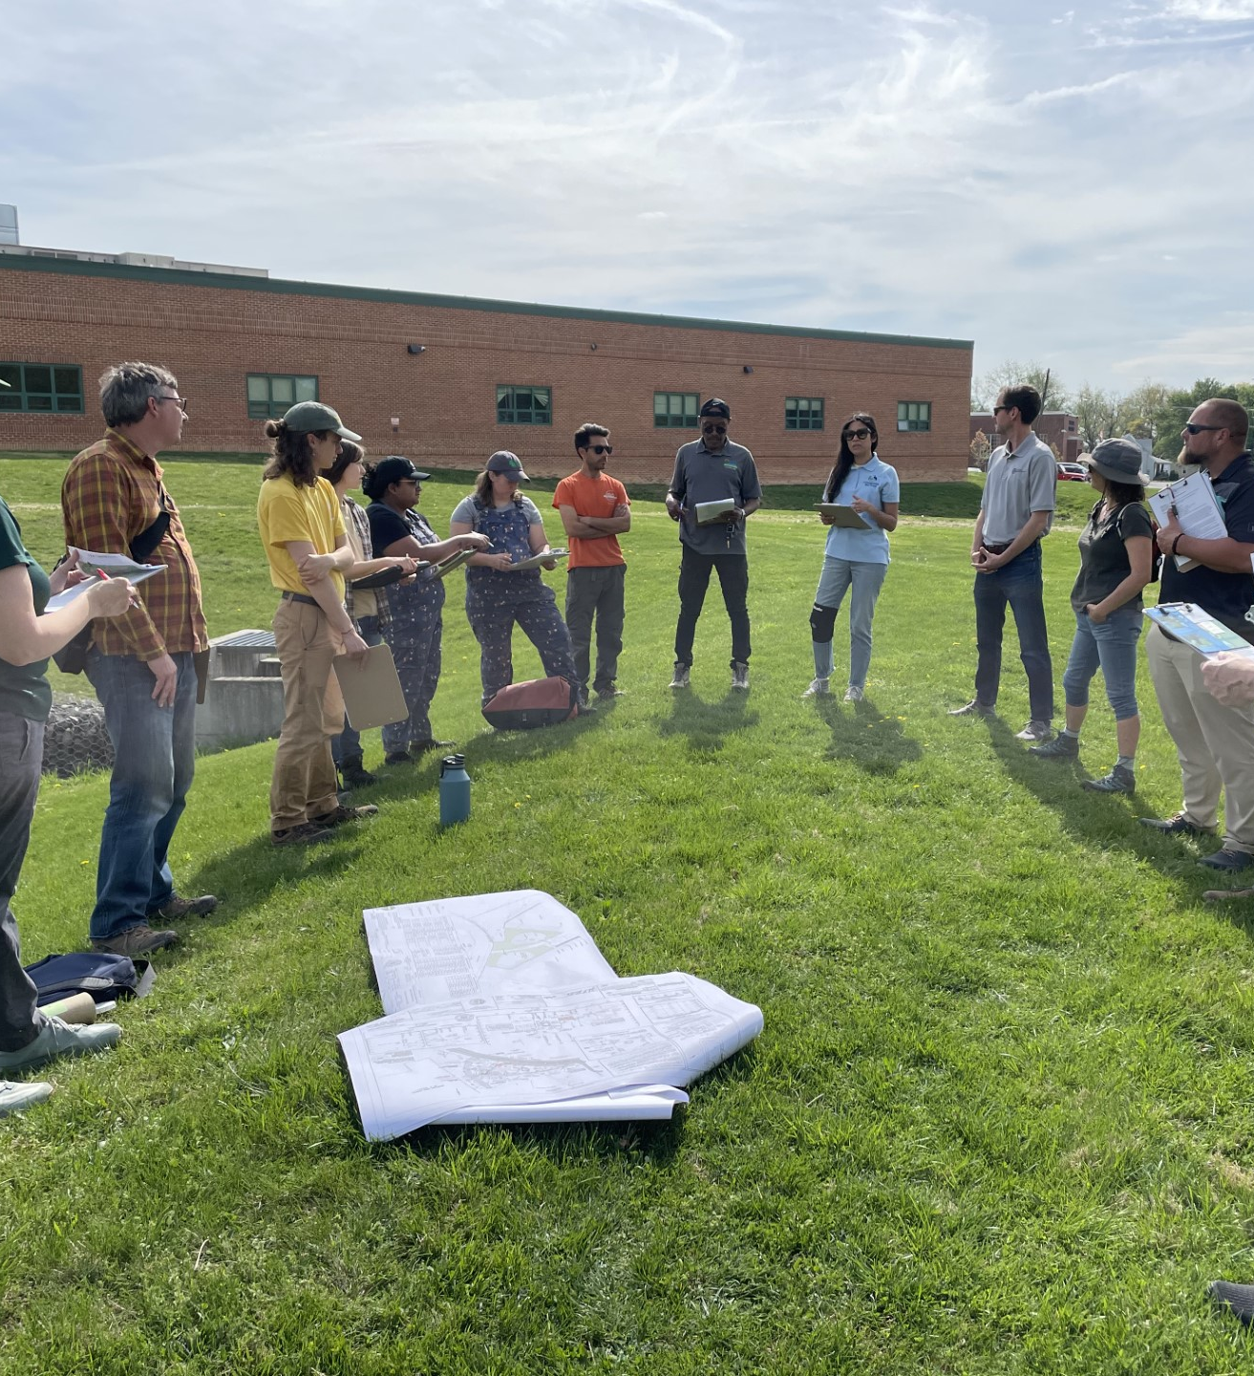
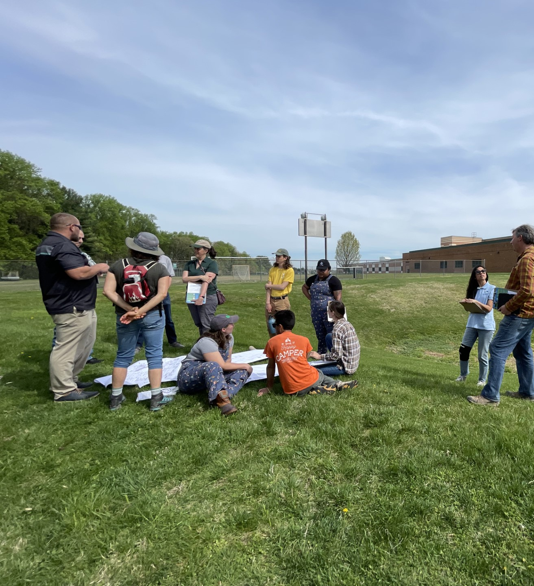
Kick off meeting – April 14, 2023
Participants included:
The Chesapeake Bay Trust
Howard County Government
Watershed Stewards Academy
Coastal Resources Inc.
Triangle Contracting
Howard Ecoworks
The Community Ecology Institute
Notes:
CEI continues to lead these grant applications not only because we are deeply connected to the community and to the different stakeholders associated with this work, but because we have found collaborative innovation to excite and engage people in meeting shared challenges. Throughout these grants and associated projects we have partnered with the University of Maryland Extension’s Howard County Watershed Stewards Academy, Biohabitats to develop the design to address the stormwater flowing onto Freetown Farm, Skeo Solutions on the walkable watershed design plans for Atholton High and the surrounding Hickory Ridge community, Howard EcoWorks and Triangle Contracting on the BMP installation elements at both the farm and the school, and Coastal Resources Inc to supervise the construction of the Atholton project. We have also worked in collaboration with the Howard County school system staff, dozens of stakeholders, and community residents.

Slide 5
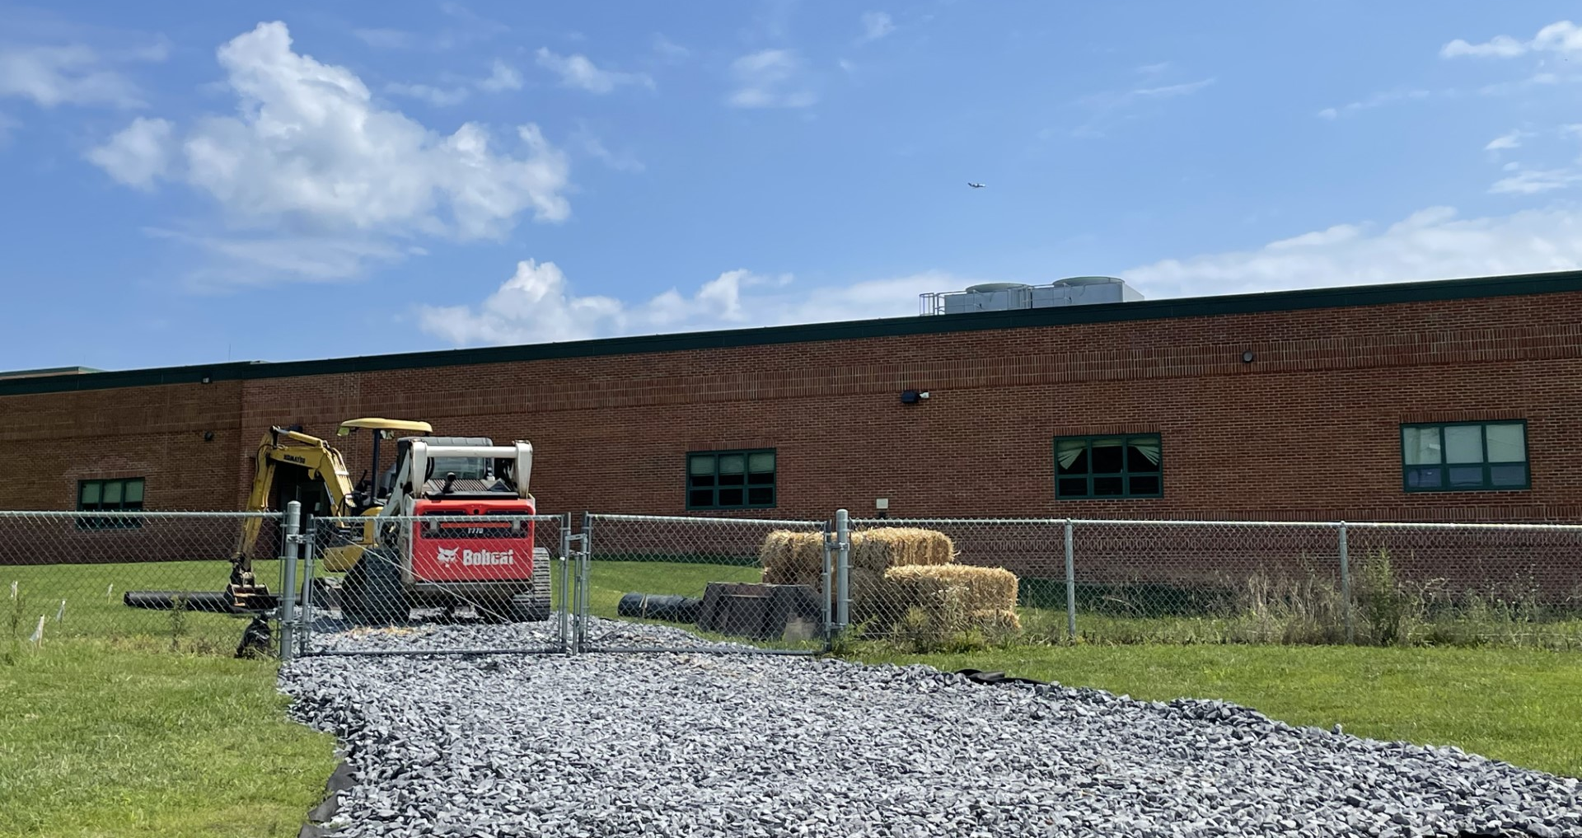
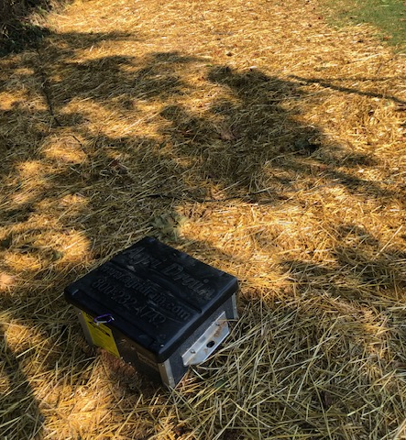
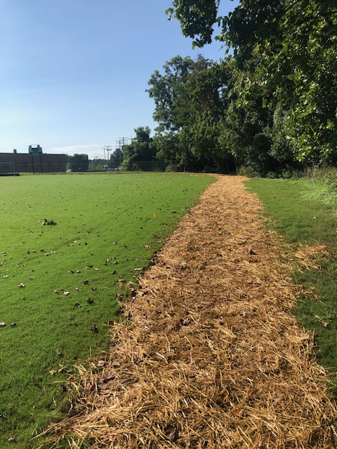
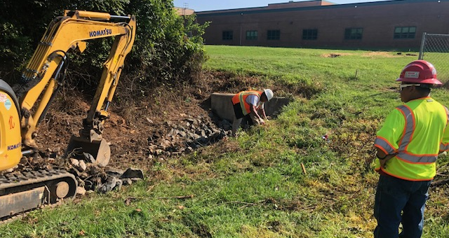
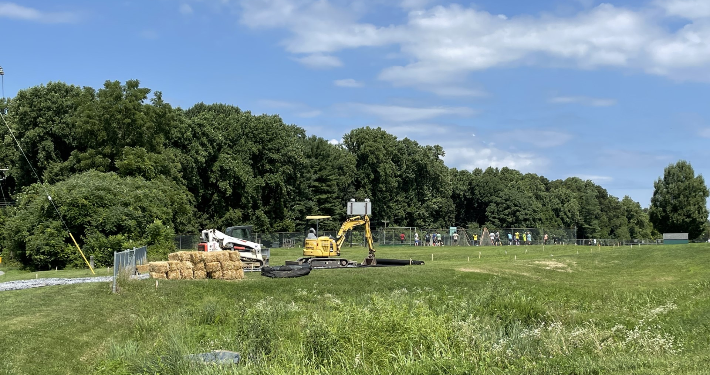
Infrastructure work – summer 2023
Completed by Triangle Contracting

Slide 8
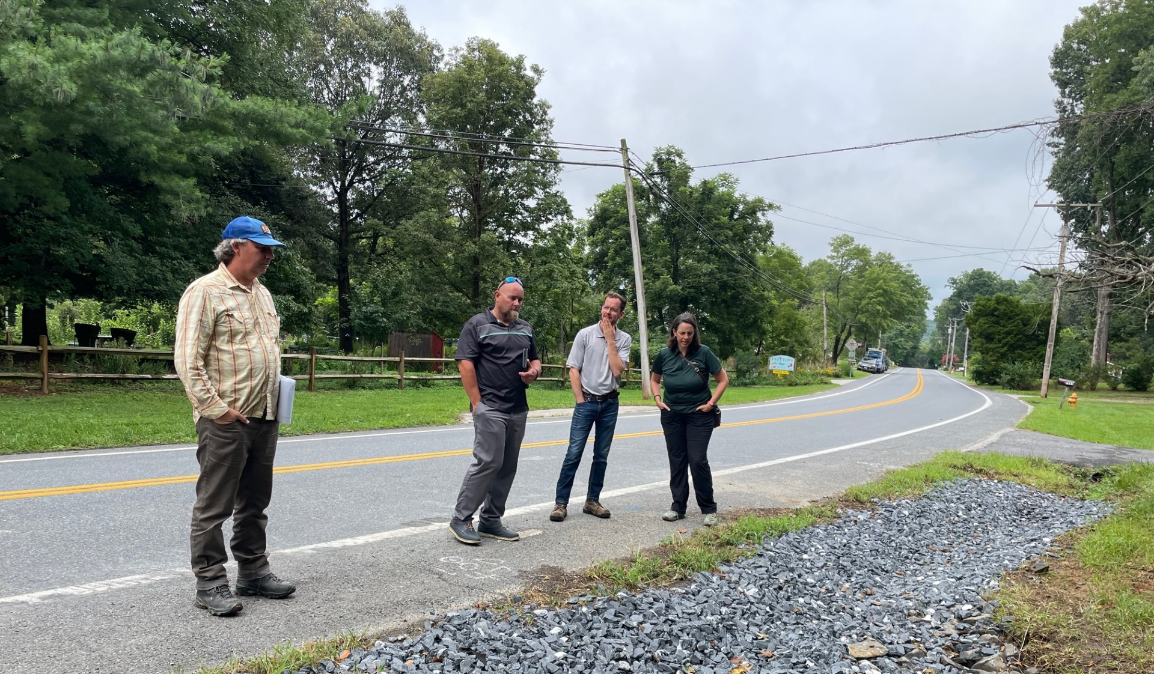
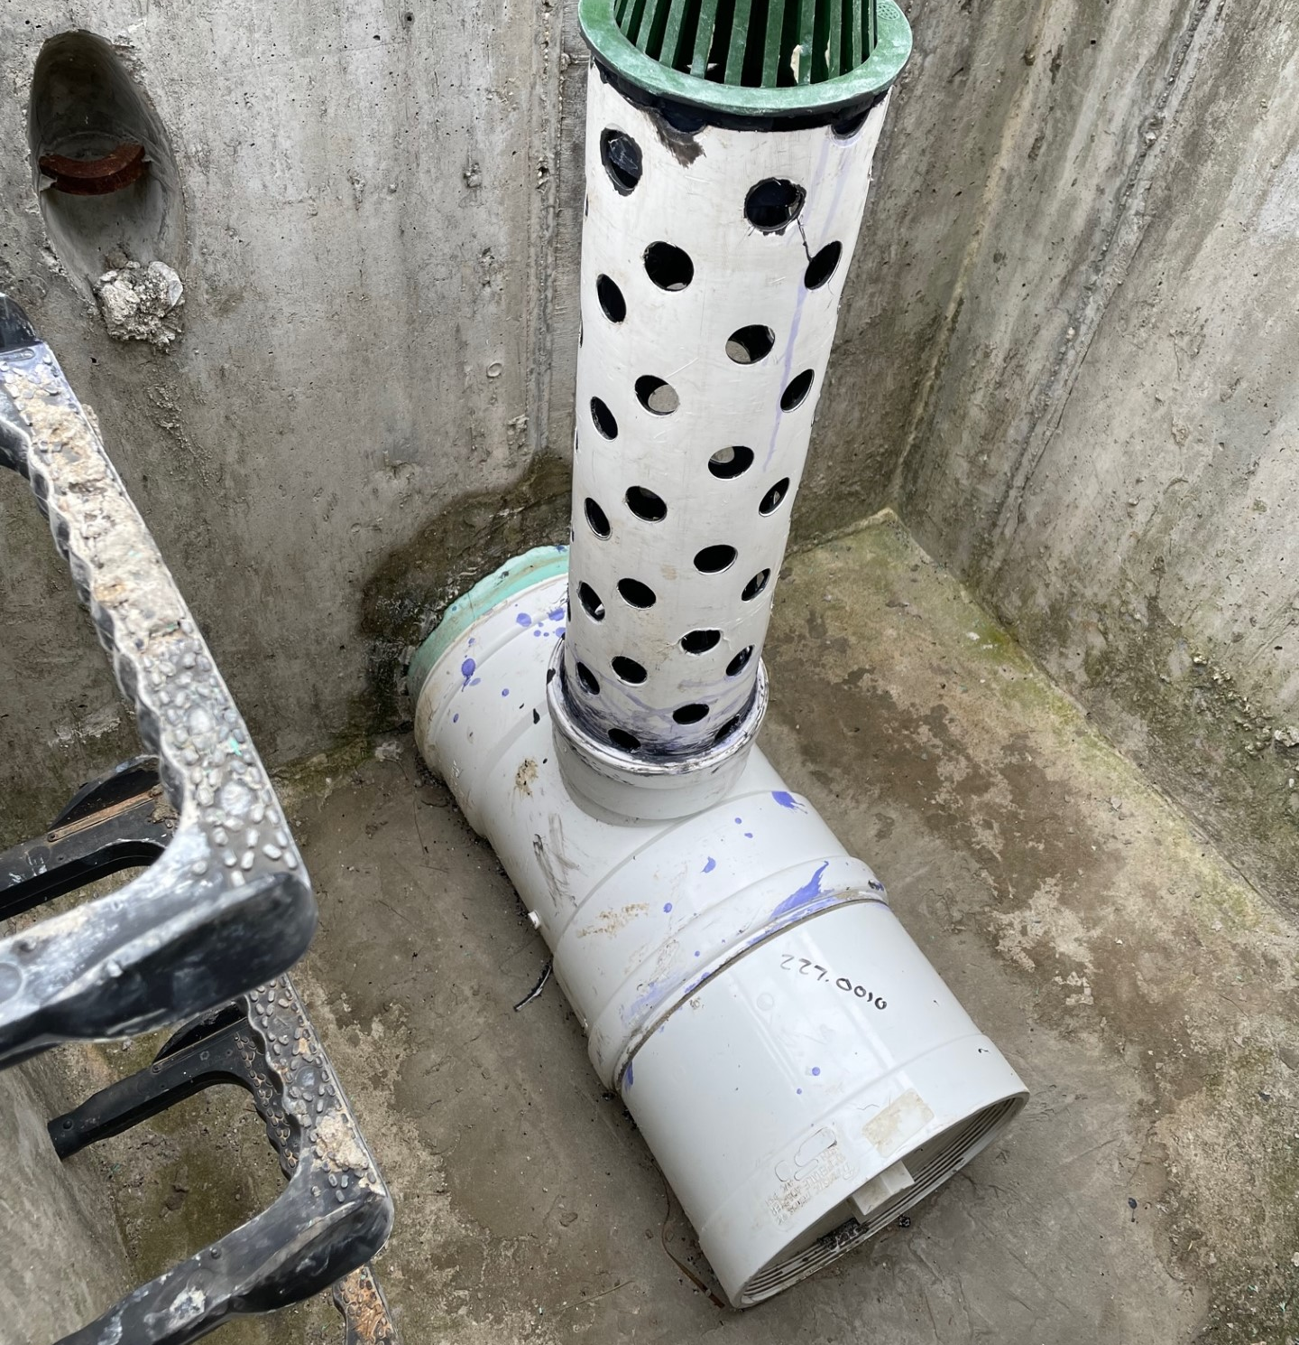
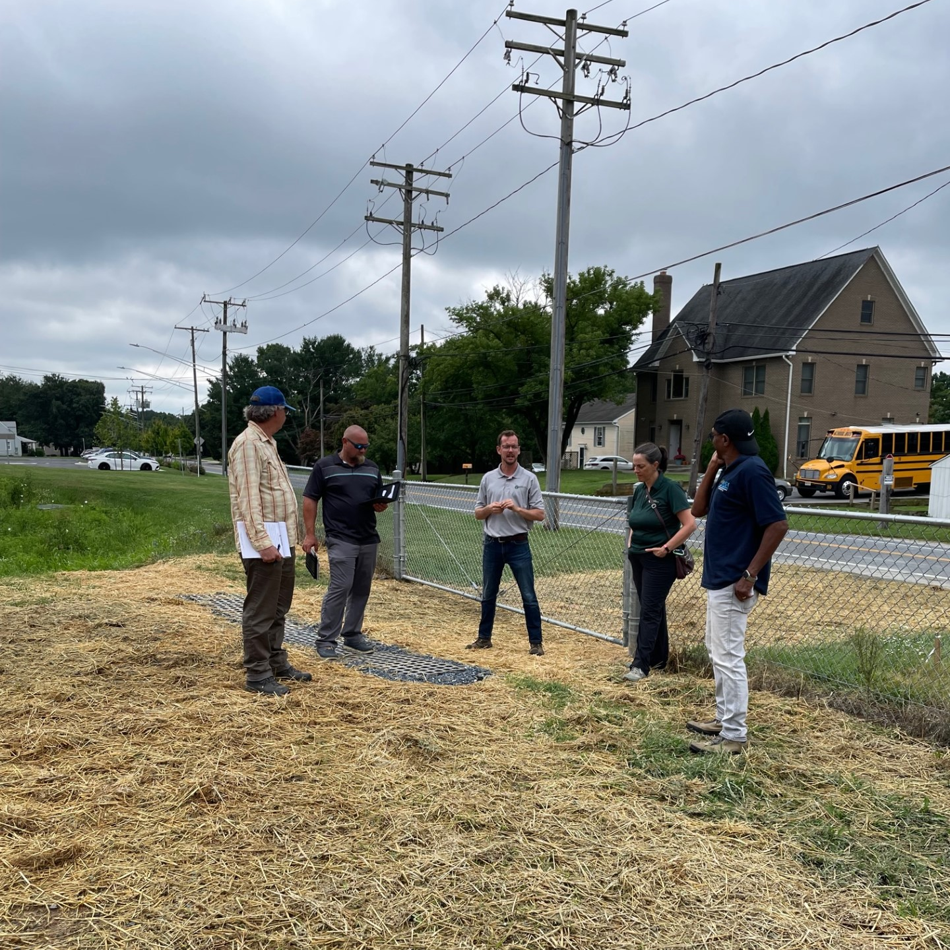
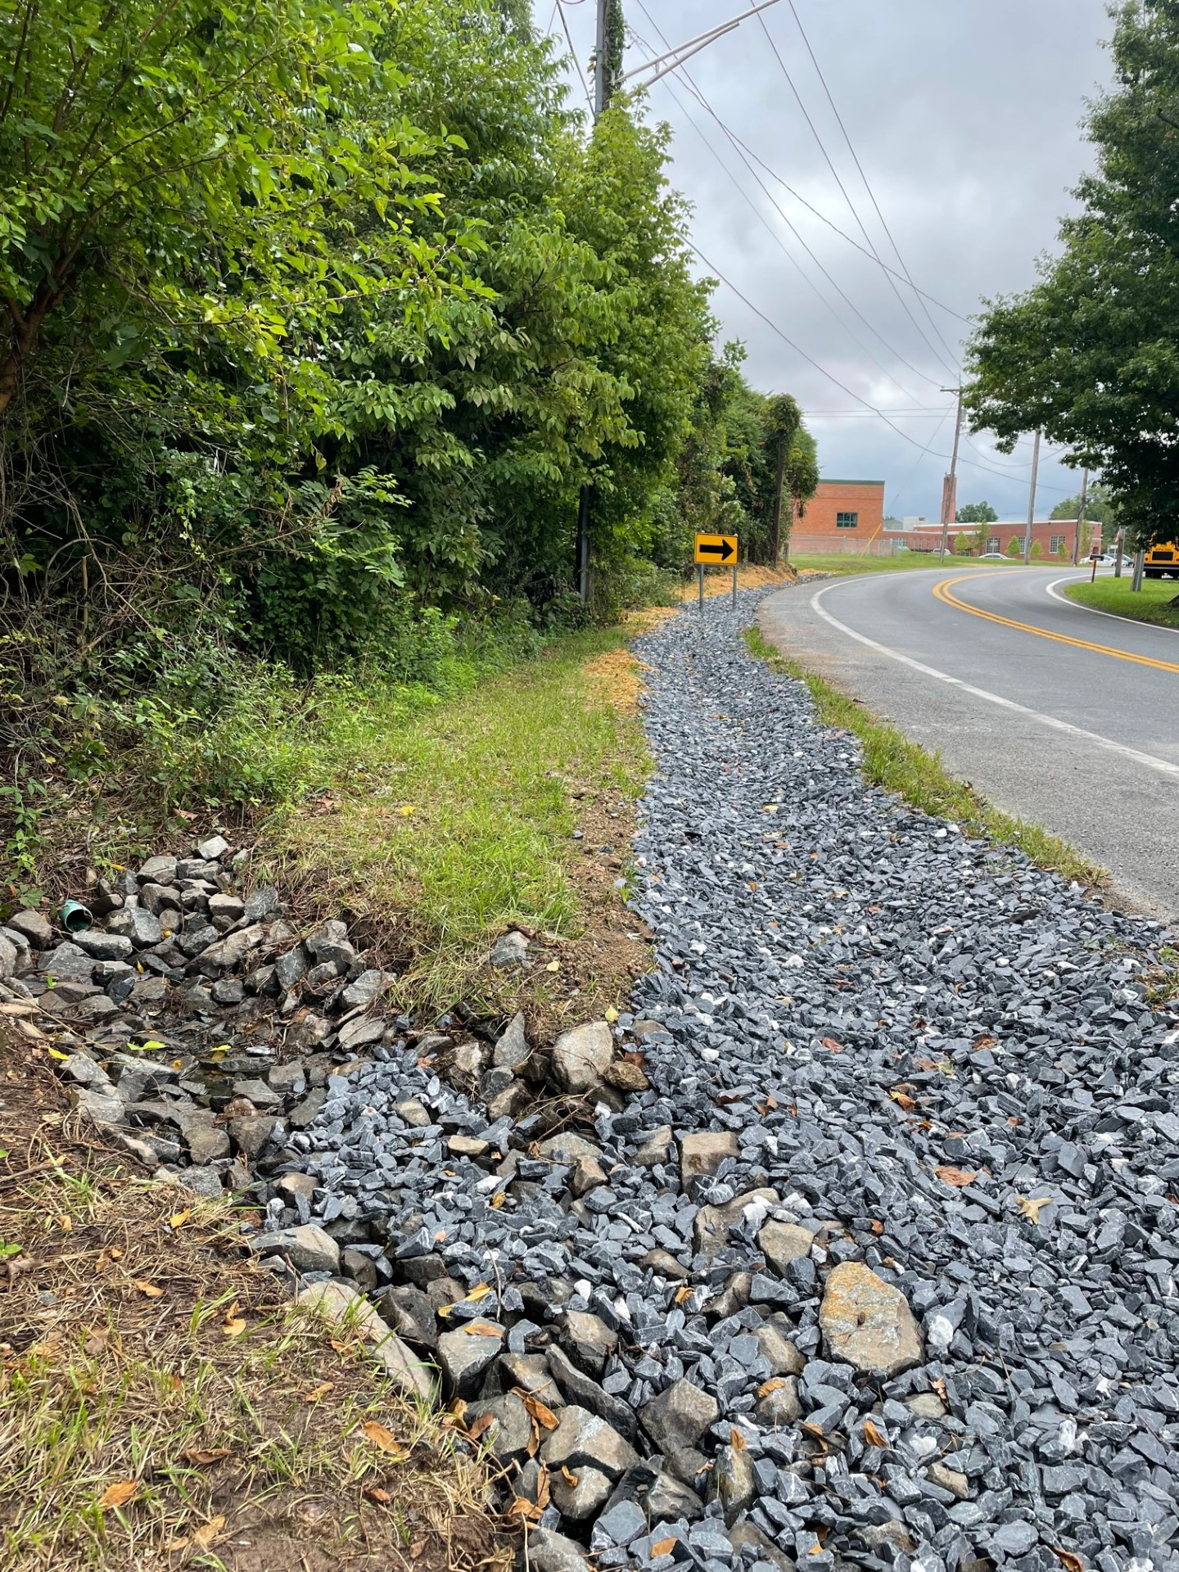
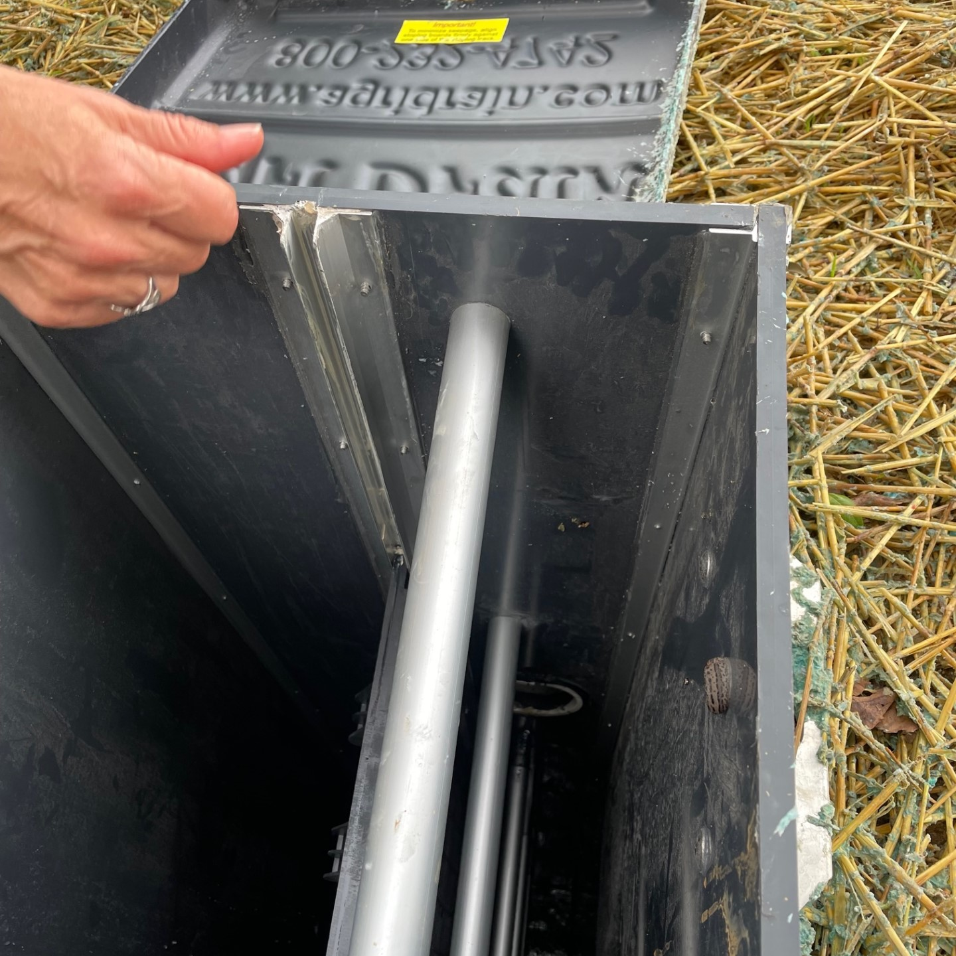
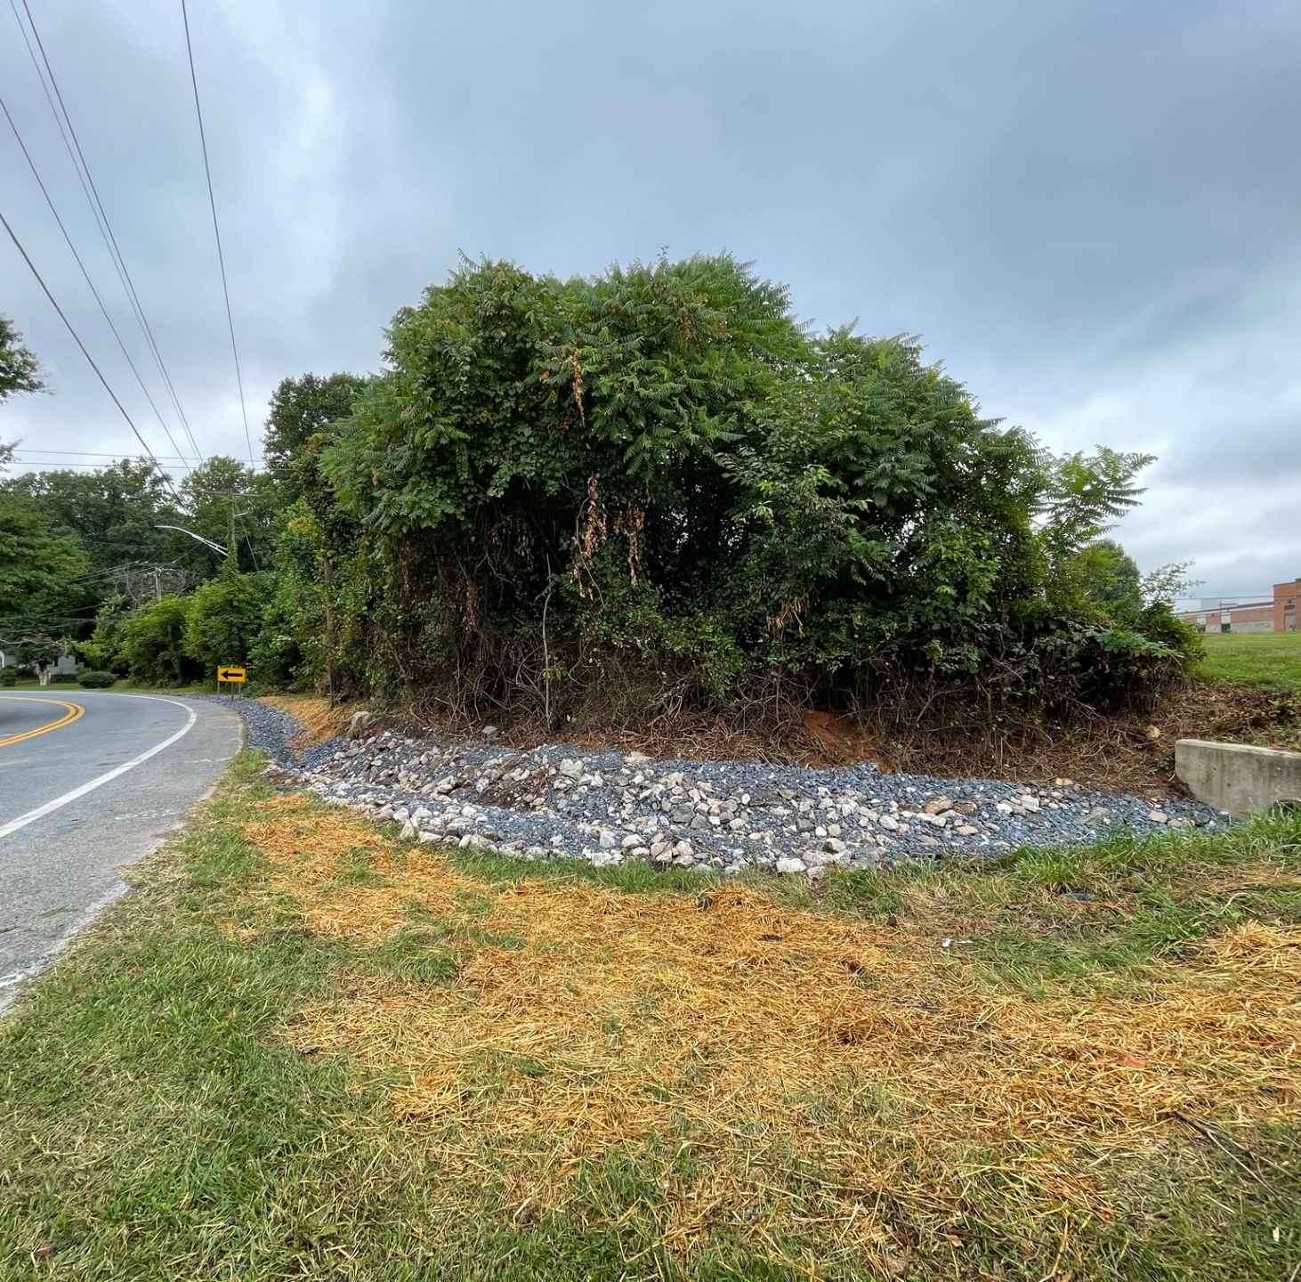
Post infrastructure work walk through August 7
Construction and project engineering oversight provided by Coastal Resources, Inc.

Slide 9
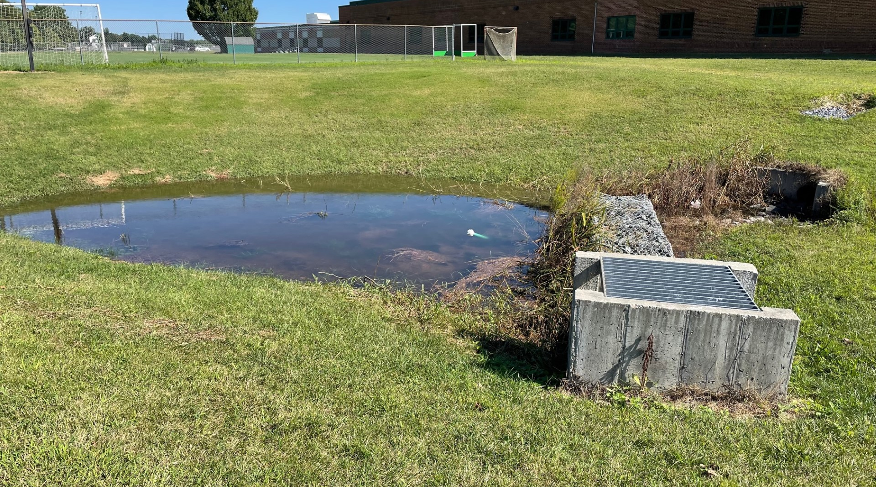
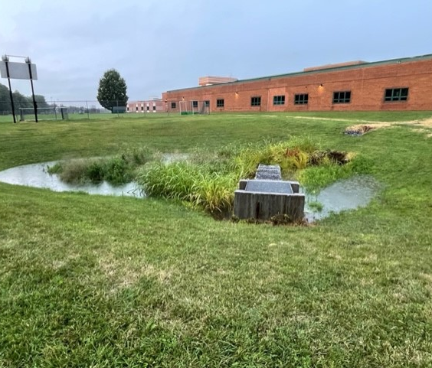
After the first rain – the ponds work!
No one on the project team had seen the ponds hold water before the infrastructure improvements were completed.

Slide 10
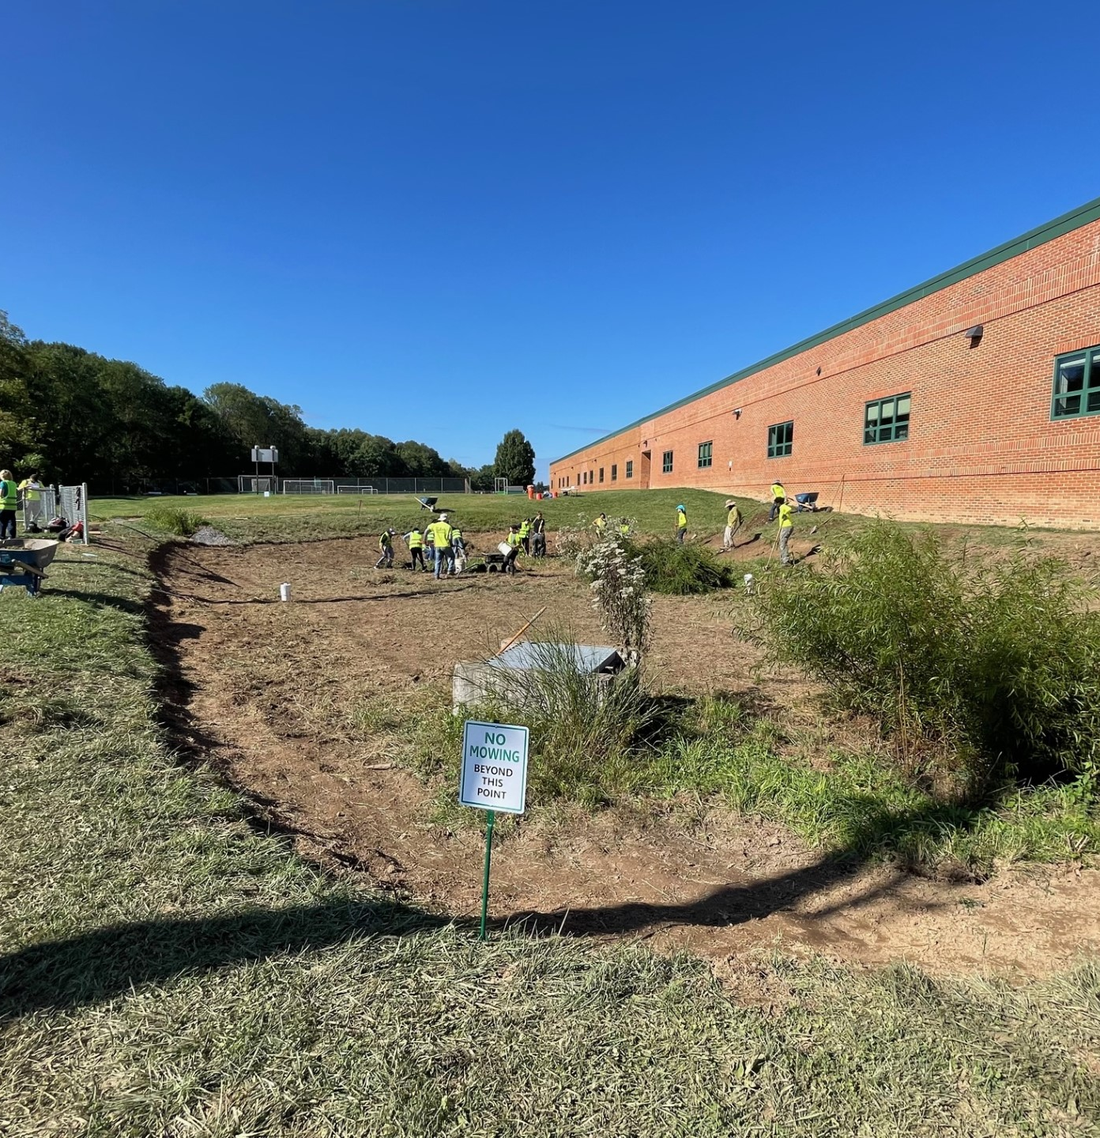
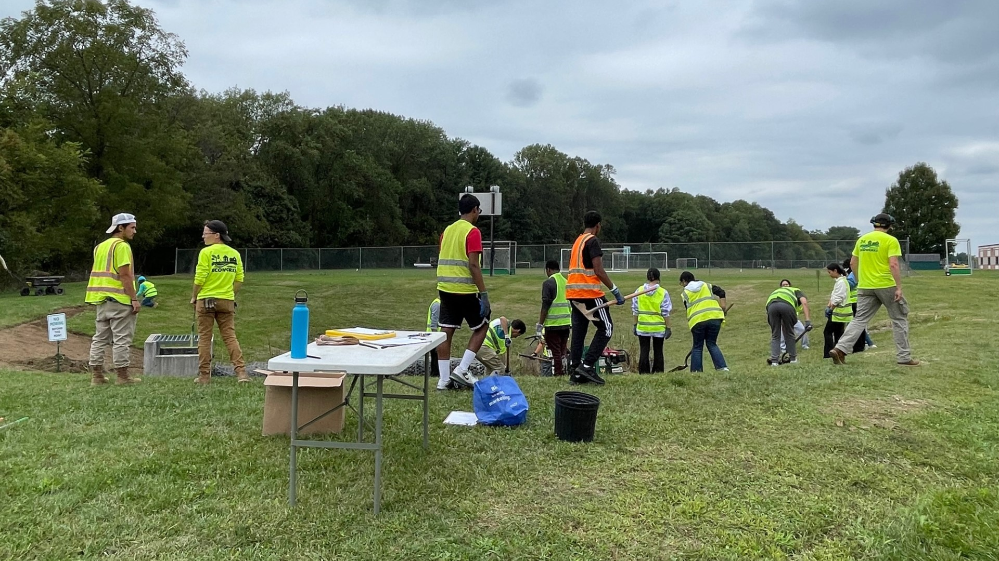
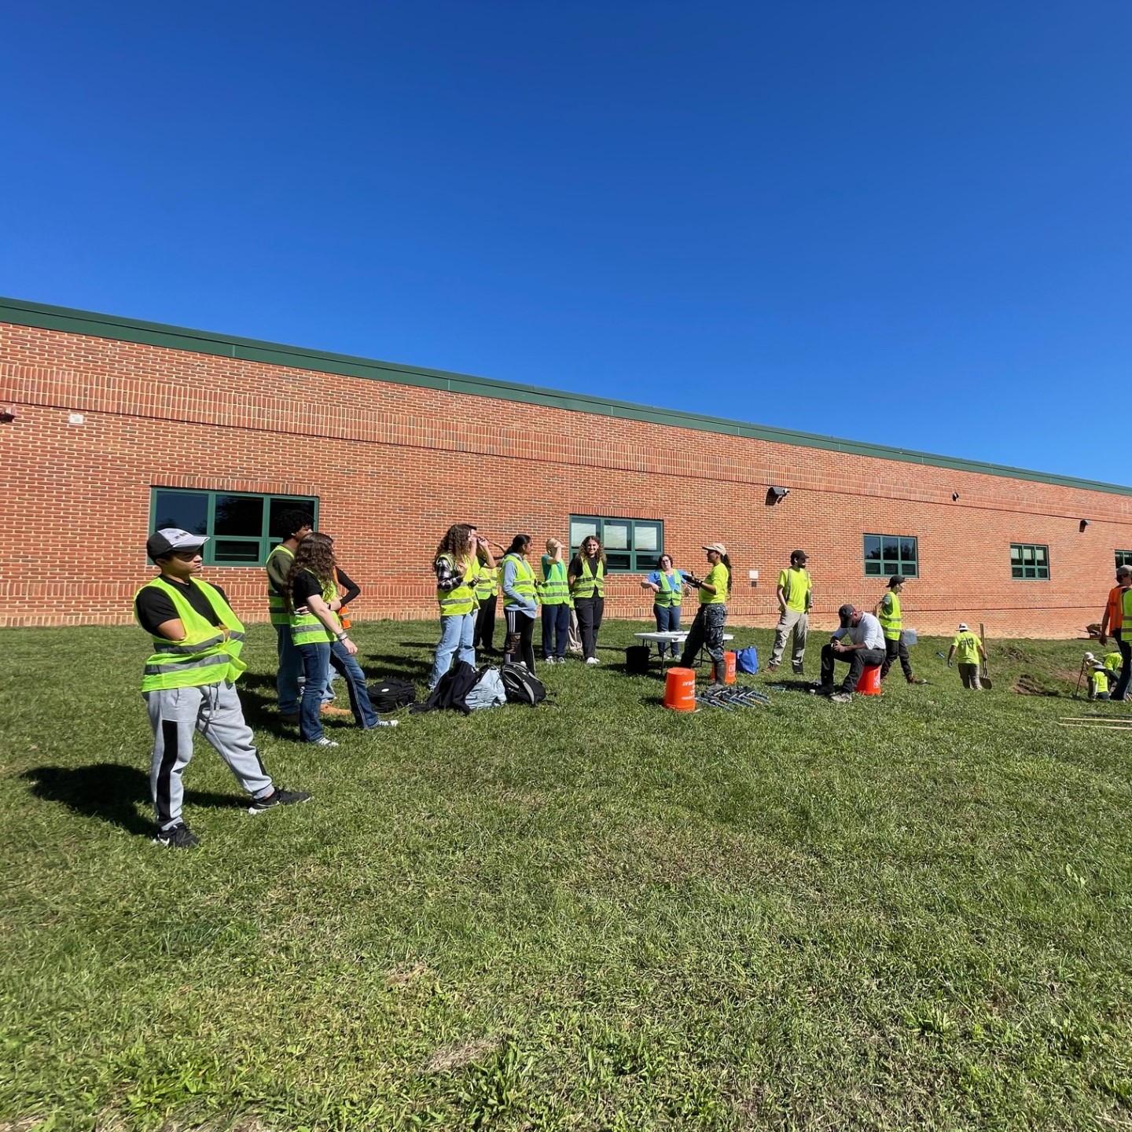
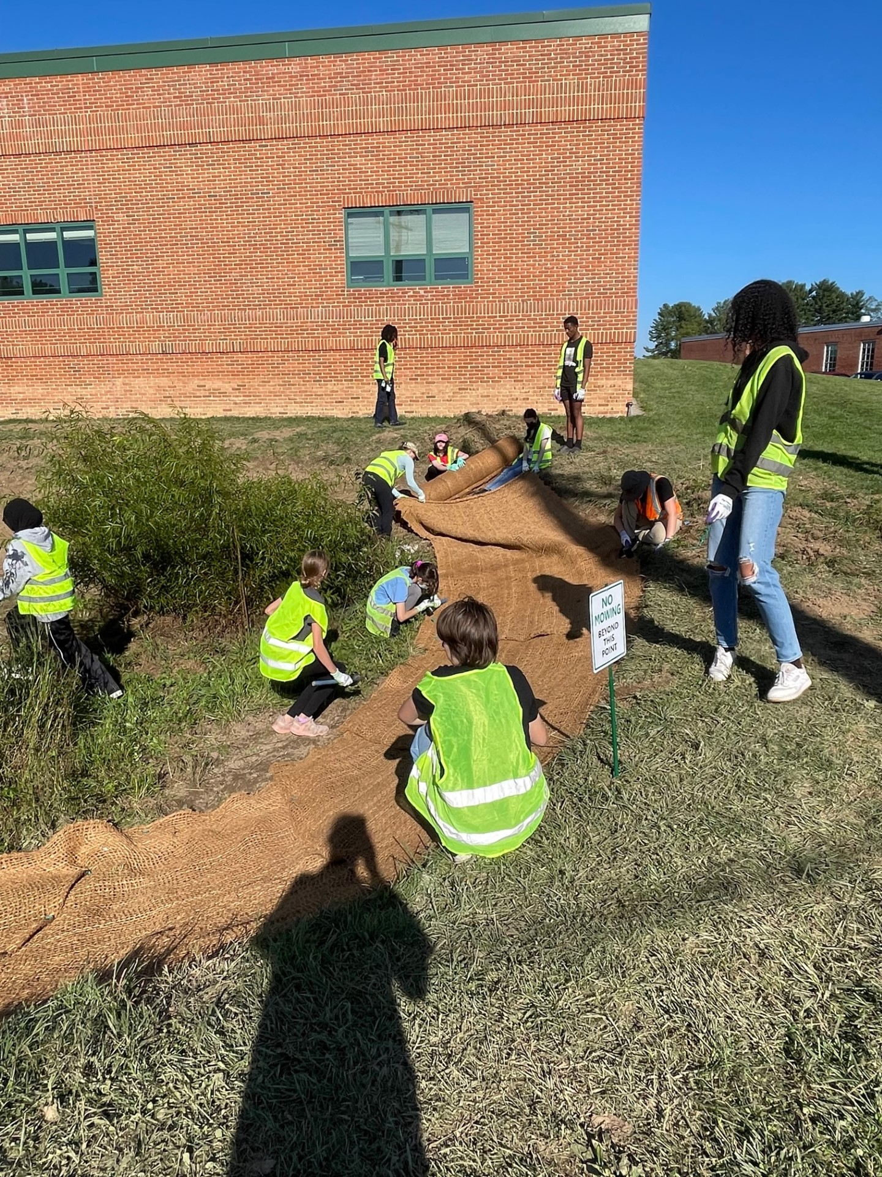
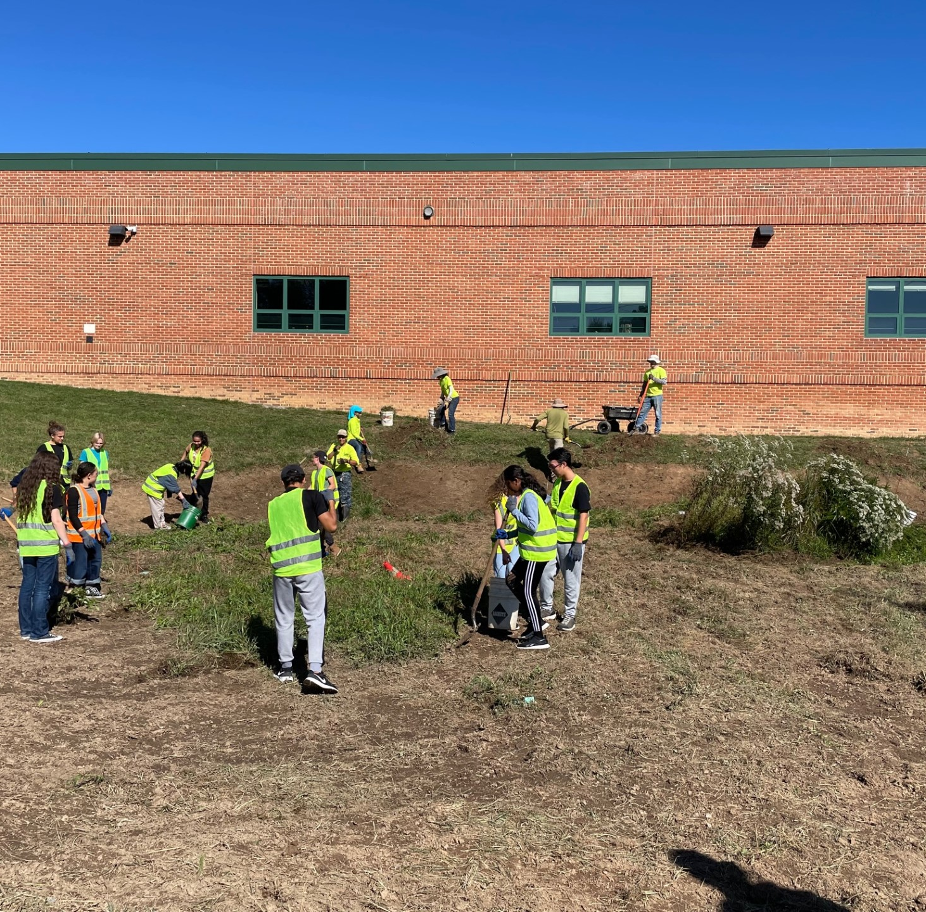
Volunteer days – Sept & Oct
Planting the project area with Atholton student clubs and CEI Green SEEDS interns.
Notes:
Brandon Sands, the Manager of Grounds Services for the Howard County Public School System, shared “On behalf of HCPSS, I would like to thank the members of the Community Ecology Institute, Howard EcoWorks, Coastal Resources, and the Chesapeake Bay Trust, for their superior work on the Atholton High School stormwater management project. It was a pleasure to have such a collaborative effort on this successful project. I look forward to working with this group on future projects and further educating students, staff, and patrons on the importance of proper stormwater management, conservation, and native landscaping.”

Slide 12
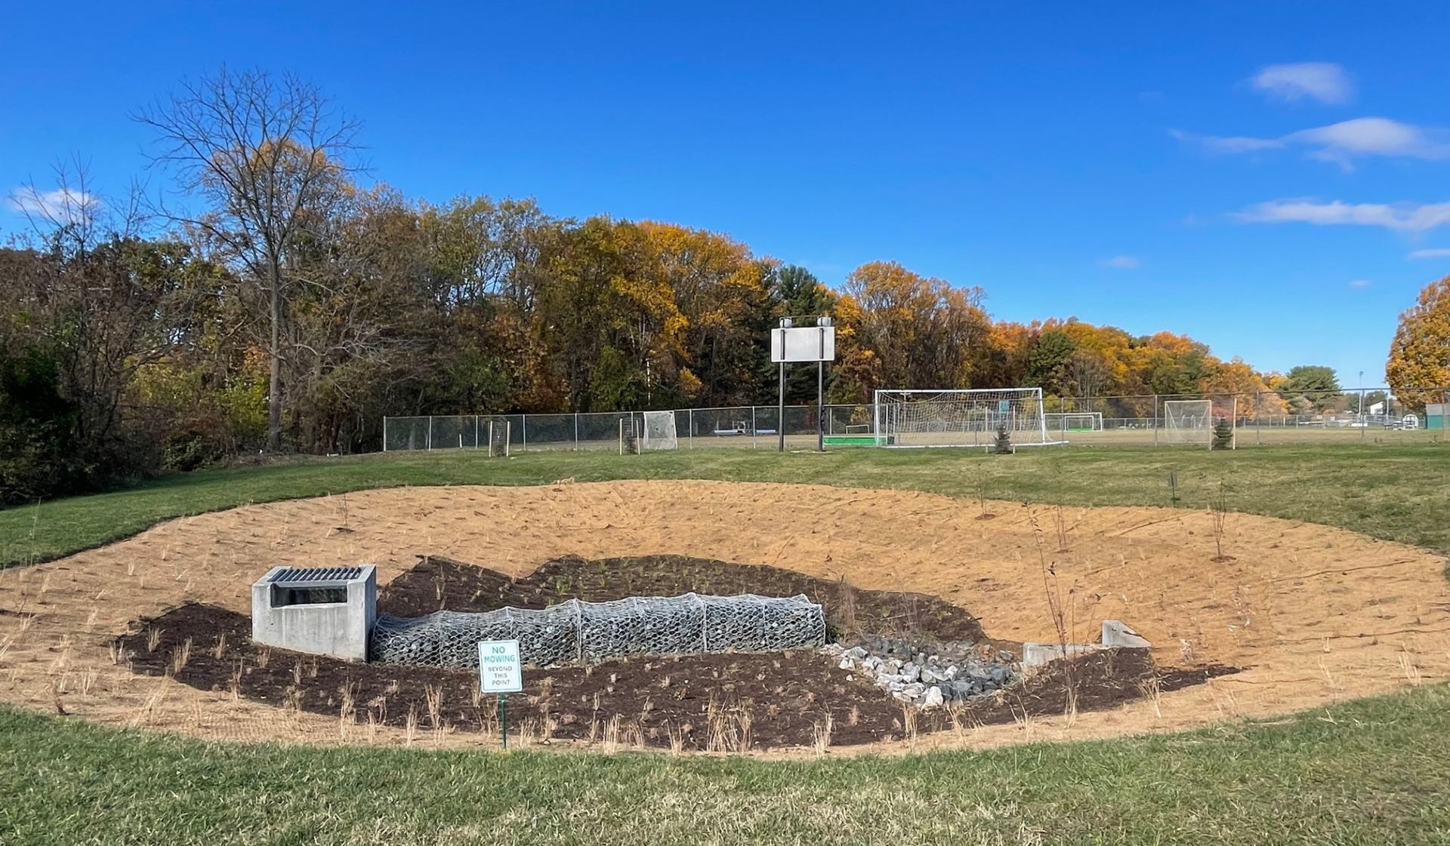
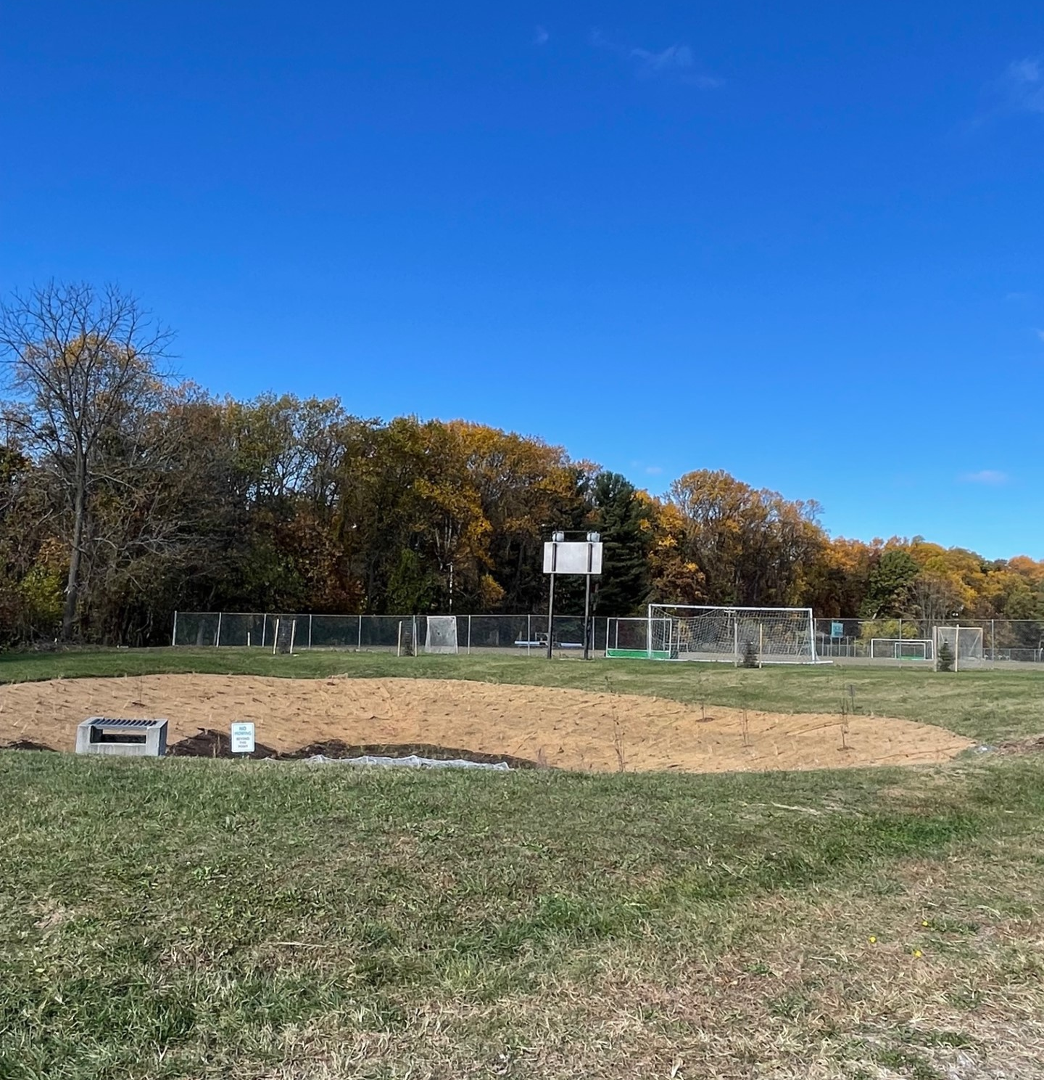
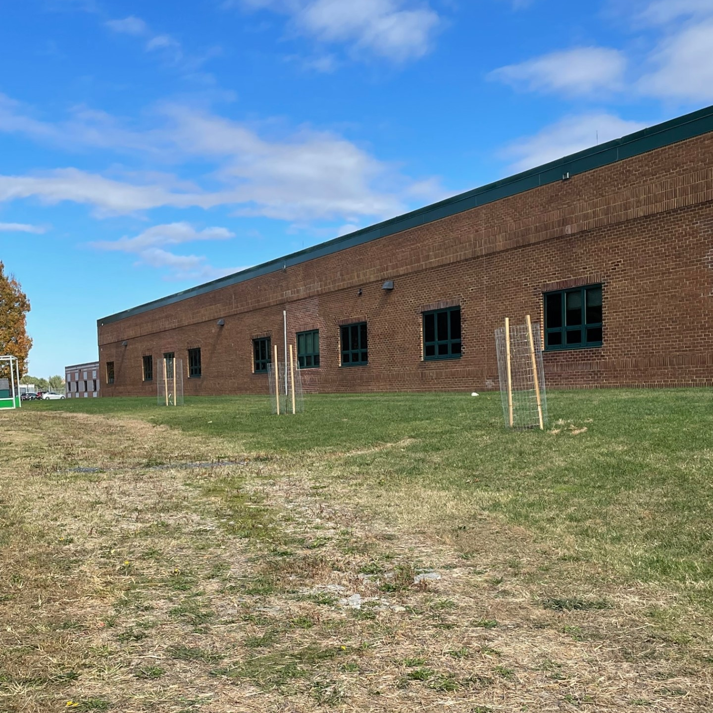
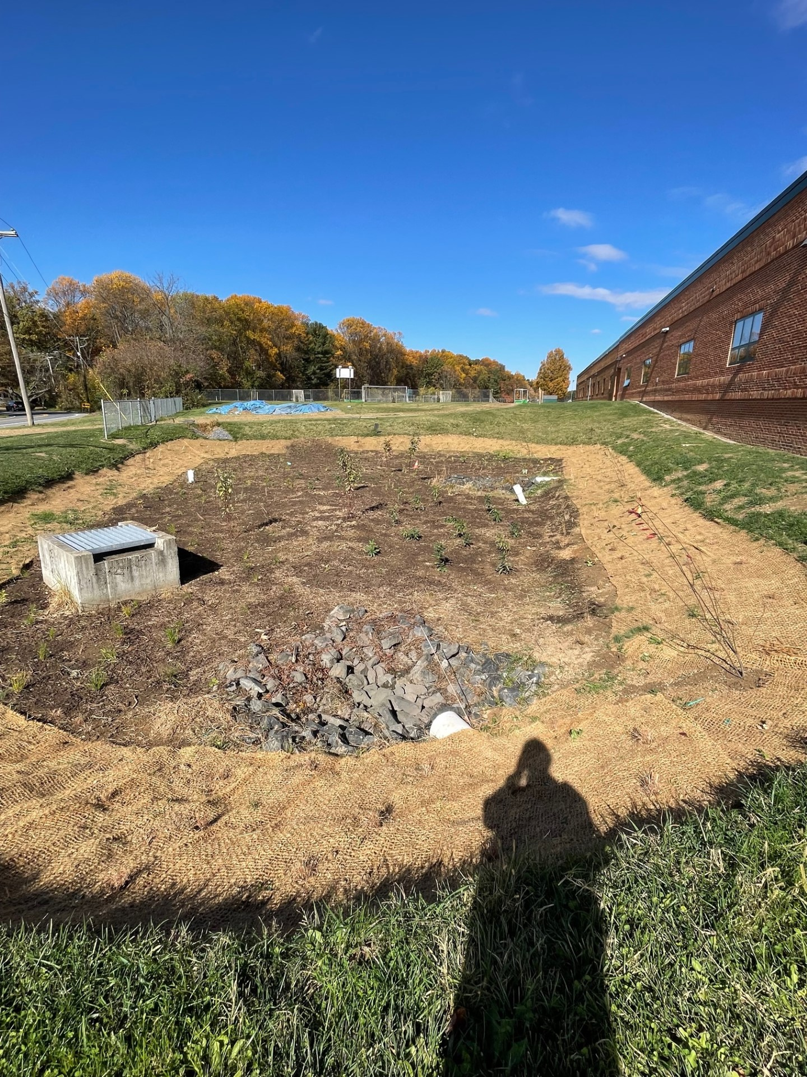
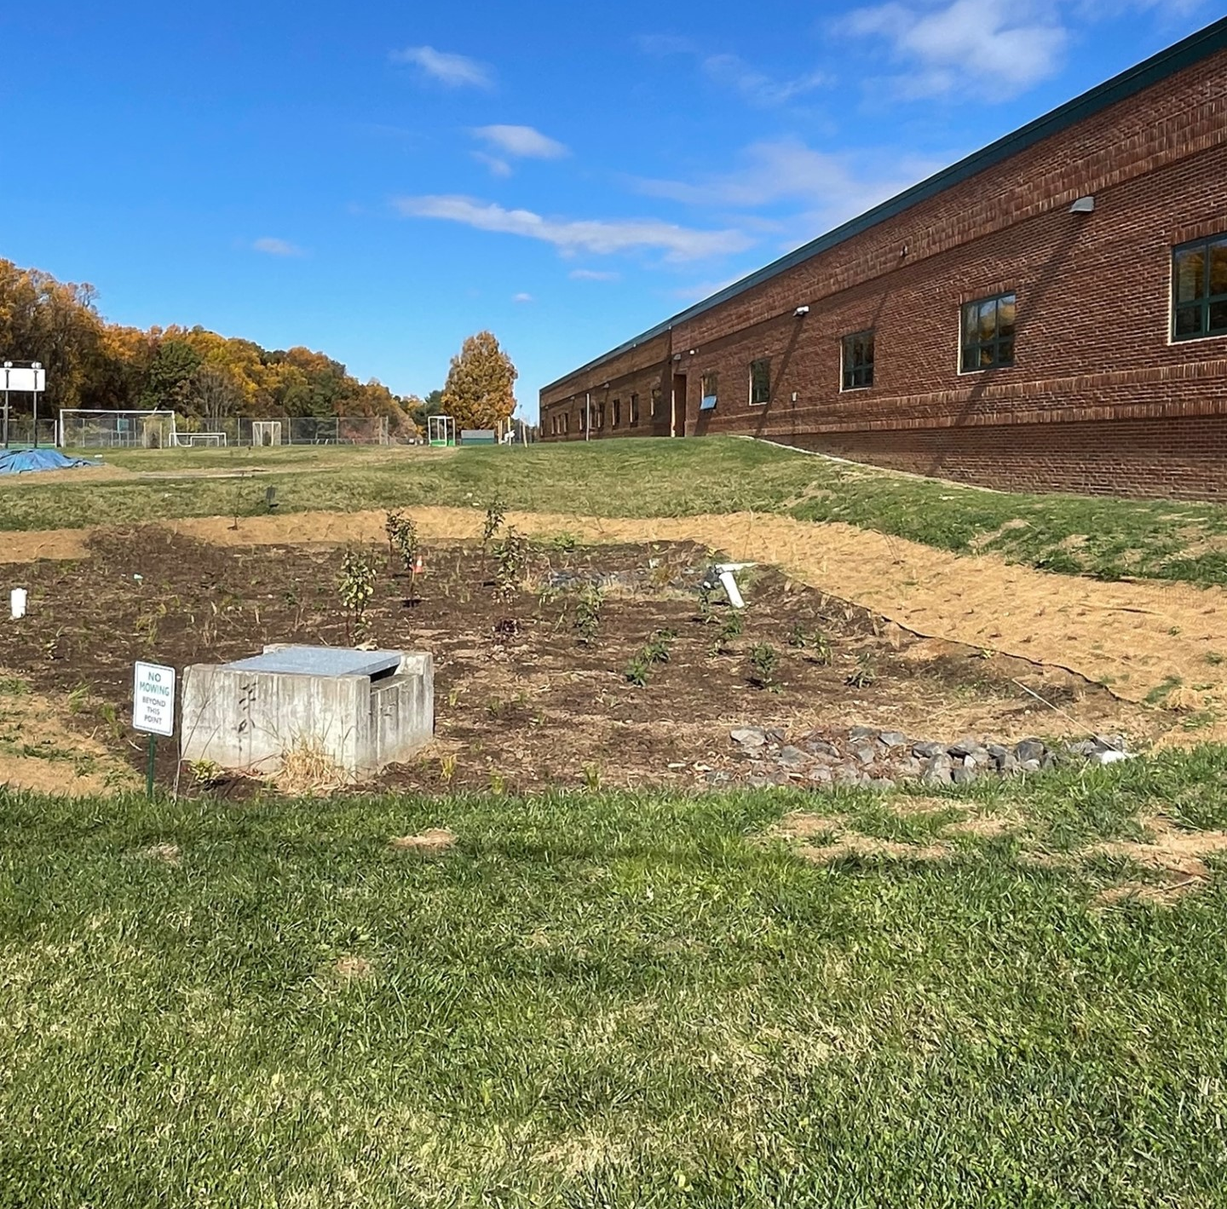
Post – planting October 30, 2023
Planting completed by Howard EcoWorks

